Slide 1
Called 2 Collaborate:
An Interprofessional Approach to Public Health Education
Marshare Penny
Dayna Herrera, Jolene Dickert, Nicole MacDonald, Heather Ontiveros, Bryan Ness, and Sarah Pearce
American Public Health Association
147th Annual Meeting & Exposition
Monday, November 4, 2019
Philadelphia, Pennsylvania
Session 3170.0

Slide 2
1)The following personal financial relationships with commercial interests relevant to this presentation existed during the past 12 months:
Presenter Disclosures
Marshare Penny
No relationships to disclose

Slide 3
Overview
Learning Objectives
Who are we?
CBU IPE: Called 2 Collaborate
IPE Curricula
Preliminary Program Outcomes
Future Directions

Slide 4
Learning Objectives
List one benefit and one challenge of collaborations across health profession academic programs
Describe the elements of the IPE curricula at California Baptist University.

Slide 5
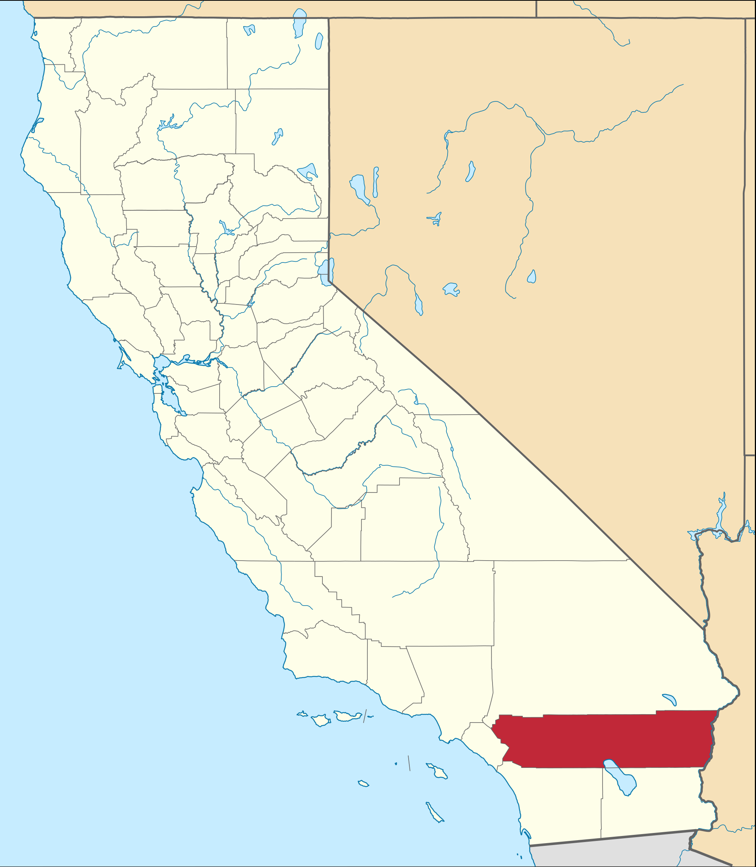
California Baptist University (CBU): Who are We?
Private Christian college in Riverside, CA
Live Your Purpose!
11,045 students
Public Health Programs
  An MPH program (n=70)
  A BSPH program (n=25)
Notes:
MPH represents 12% of the IPE population, with nursing representing the largest proportion at 29%

Slide 6
CORE VALUES
Notes:
Driven by our Christian commitment, CBUs MPH Program prepares students to serve as practitioners, researchers and educators in the area of public health, who are capable of improving and preventing local, national and global health problems by delivering life-span health and wellness education through excellent teaching and mentoring, meaningful scholarship and servant relationships.

Slide 7

What is Interprofessional Education (IPE)?
“Interprofessional education occurs when students from two or more professions learn about, from, and with each other to enable effective collaboration and improve health outcomes. Once students understand how to work interprofessionally, they are ready to enter the workplace as a member of the collaborative practice team. This is a key step in moving health systems from fragmentation to a position of strength.”
Source: World Health Organization (WHO). (2010). Framework for action on interprofessional education & collaborative practice. Geneva: World Health Organization.
Notes:
In 2009 six national education associations of schools of the health professions formed a collaborative to promote and encourage constituent efforts that would advance substantive interprofessional learning experiences to help prepare future health professionals for enhanced team-based care of patients and improved population health outcomes. These organizations that represent higher education in allopathic and osteopathic medicine, dentistry, nursing, pharmacy, and public health created core competencies for interprofessional collaborative practice to guide curricula development across health professions schools.
Although the original 2011 panel focused its recommendations on the professions of medicine, nursing, pharmacy, dentistry, and public health, IPEC continues to engage multiple health professions in its efforts to guide curriculum development across health professions schools.

Slide 8
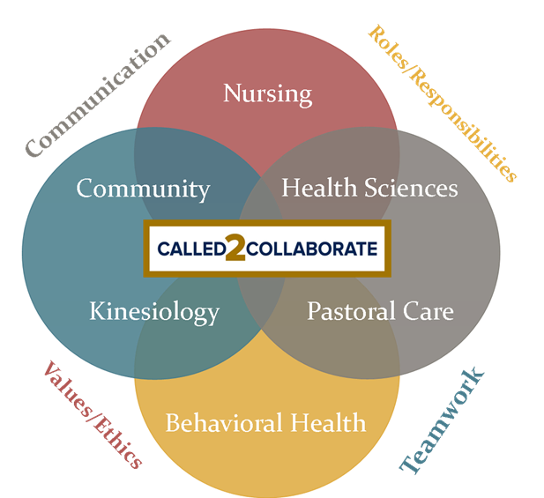
Called 2 Collaborate
A collaboration between health profession graduate programs at CBU
Led by our College of Nursing
Comprehensive IPE Program & Curricula

Slide 9





Participating Graduate Programs
Athletic Training
Nursing
Physician Assistant
Psychology
Public Health
Social Work
Speech-Language Pathology
Notes:
All programs have a faculty lead that attends bi-monthly meetings is active in development of curriculum. Tyr to ensure the # of faculty involved reflect the size of the grad program. Eg. PH has 20-30 students for each cohort, so 2-3 faculty participate.

Slide 10
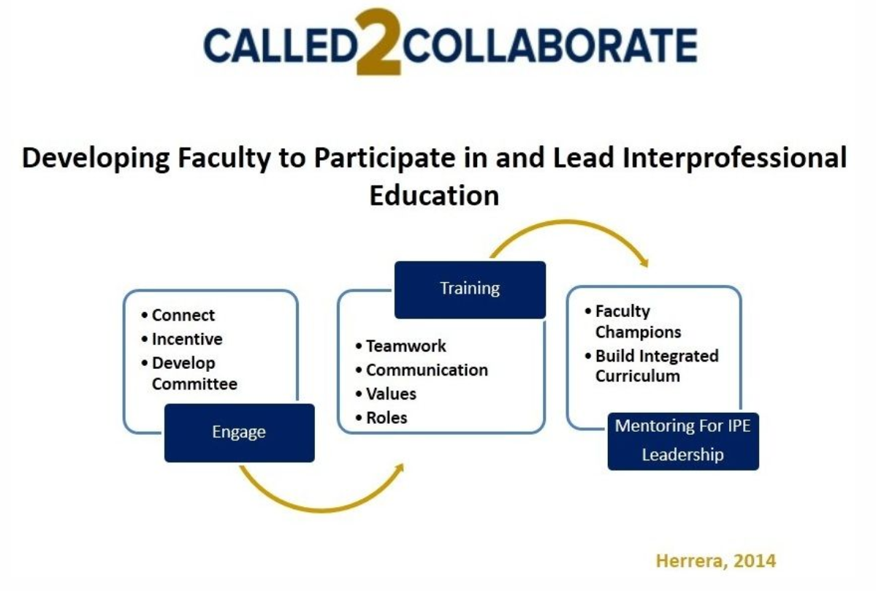

Slide 11
Curricula
IPEC Competency Domains
Domain 1
Domain 2
Domain 3
Domain 4
Roles and Responsibilities
Values and Ethics
Communication
Teams and Teamwork
These domains cut across all instructional areas and address:
  Knowledge
  Skills/Behaviors
  Attitudes

Slide 12
IPE Curricula
Exposure: IPE 510 Introduce (fall semester)
Immersion: IPE 520 Engage (fall semester)
Competence: IPE 530 Collaborate (spring semester)
Notes:
Each program may insert their students at slightly different intervals.
Introduce learners early in their educational programs to engage in activities that offer knowledge based information, focused on “describing roles and responsibilities” and “demonstrating awareness of interprofessional (IP) communication and teamwork in the context of shared curricular topics required across health professions. An introductory level hybrid course of Inter-Professional Education Collaborative (IPEC) competencies and an end of course seminar for all students will be required.
Engage intermediate learners in their educational program together through their own programs activities that provide opportunities to continue to build upon IPE competencies. Programs will integrate multifaceted active teaching methods such as simulation, problem based learning, clinical practicum, community –based projects, service-learning, and other IPE activities.
Integrate advanced learners to work collaboratively as appropriate, to assess, plan, provide care/intervention and make decisions to optimize client/patient, family, and community health outcomes and improve quality of care through a University wide IPE simulation. Students will draw upon previously learned knowledge, skills, and attitudes related to the four domains of IPE education to effectively apply leadership qualities that support collaborative practice, and team effectiveness.

Slide 13
Timeline
Begin rolling out curriculum in fall 2015
An average of 120 students each year
Fall 2019 has the largest cohort of 206
  AY 2015-2020: N=686
Notes:
As of fall 2019, we have reached full integration across health professional programs.

Slide 14
IPE 510 - Exposure

Slide 15
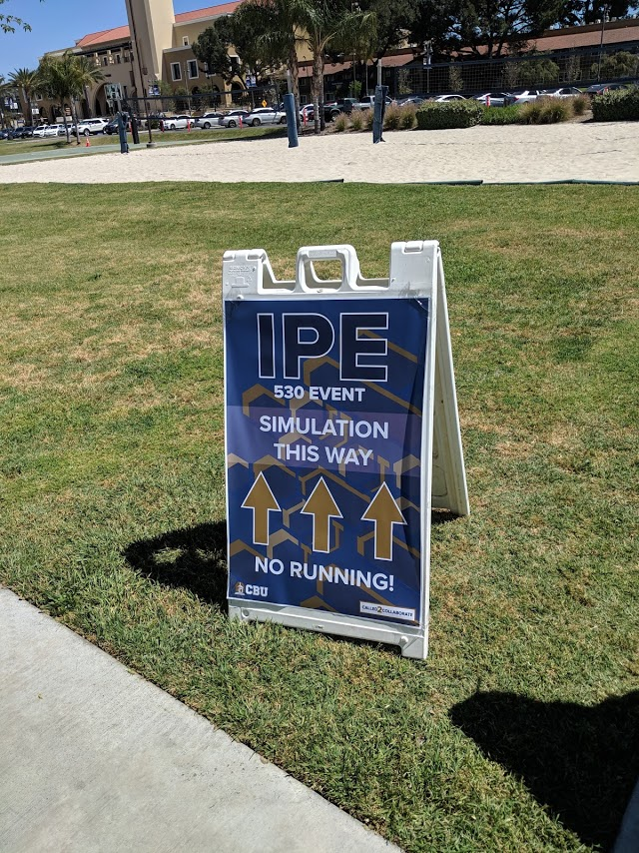
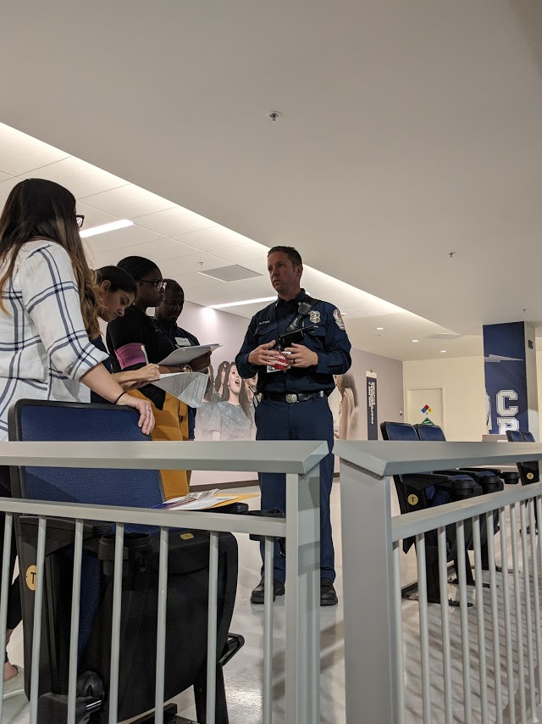
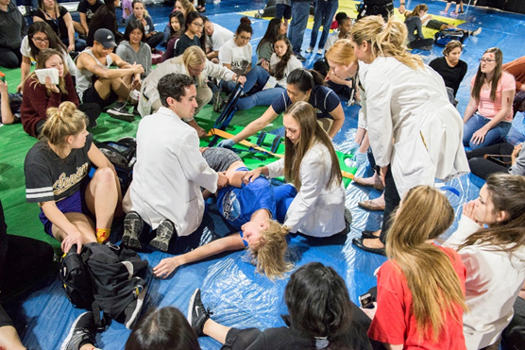
IPE 530 Competence-
Simulation

Slide 16
Program Outcomes-
Assessment Opportunities
Spring 2019- Interprofessional Collaborative Competencies Attainment Survey (ICCAS) pilot using IPE 530
Fall 2019- full implementation of ICCAS; pre IPE 510 and post IPE 530
Actor Feedback
Student/Participant Feedback
MPH Annual Student and Alumni Surveys
Notes:
There are also course assignments in IPE 510 and IPE 520

Slide 17
Preliminary Findings
Pre/Post IPE 530 using ICCAS:
  Measured six (6) domains
  Increases in self-reported knowledge, skill and abilities
Among MPH students:
  After the first year in the program, 91% report being knowledgeable/proficient in IPE
  Graduates report 100% knowledgeable/proficient in IPE (highest of all 22 CEPH areas)
Notes:
Measured 6 domains:
The ICCAS was designed to assess the change in interprofessional collaboration-related competencies in healthcare students and practicing clinicians before and after IPE training interventions. Specifically, this 20-item, self-report tool measures participants' skills in communication, collaboration, roles and responsibilities, collaborative patient-family-centered approach, conflict management/resolution, and team functioning. Using a retrospective pre-post approach, participants complete the tool after IPE training, but rate their abilities twice: once as they recall them prior to training, and again now that training is done. The results can allow IPE intervention programs to evaluate the effectiveness of interventions, as well as help individuals to reflect on how training impacts their teamwork competencies. The validity study revealed high internal consistency and a single explanatory factor underlying all six domains.

Slide 18
Trials and Triumphs
Undergoing curriculum review…ugh!
Challenges with cohorts and course rotations
Encouraging student participation
Notes:
MPH students don’t like to do things that they feel are not apart of the degree. They also seem to dislike doing things on weekends… However it has been a selling point of the MPH program.

Slide 19
Future Directions
Full implementation of ICCAS, using true pre and post versus retrospective design
Follow up assessment post graduation
Engage community partners in IPE programmatic efforts
Notes:
Do they make an effort to remain interprofessional and collaborative?

Slide 20
Acknowledgements
Thanks to the IPE team and great leadership
Jodie Dickert, EdD, ATC
Dayna Herrera, DNP
Nicole MacDonald, DrPH, ATC
Bryan Ness, PhD
Heather Ontiveros, DHSc, PA-C
Sarah Pearce, MSed

Slide 21
Thank you for your time!
Marshare Penny, DrPH, MPH
Chair and Graduate Program Director
Department of Public Health Sciences
California Baptist University
(951) 552-8385
mpenny@calbaptist.edu
https://calbaptist.edu/college-of-nursing/interprofessional-education/what-ipe

